Slide 1
General Assembly Data Science Project:
Predicting
Cost-Per-Sale for TV Advertising Campaign
Hannah Toohey • 03.22.2018

Slide 2
Overview
Dataset
Ad agency data for one client’s full 2017 campaign, media buys and response
Details
Information about all television advertising placements and corresponding calls, leads, and sales
Model
Decision Tree Regressor

Slide 3
Problem Statement & Solution
The question all advertiser’s want to answer:
How can I spend my ad dollars to get the most sales at the lowest cost-per-sale?
What factors of an ad buy affect conversion from lead to sale?
Determine the optimal media placement to hit the most efficient cost-per-sale.
Notes:
In Direct Response Television, the goal is, clearly, to elicit responses. This could mean something different for many clients, maybe a phone call, a sold policy, a free quote. However, for one of our clients, the end goal is a paid sale. Direct Response gives us the tools to track someone from just a phone call, to a lead, to a sale. It’s important for us to know exactly what pieces of our advertising are driving response, so we can continue to spend in places that generate the most efficient sales. The problem? Sales take weeks to come in, and we need to buy media today! The solution? Predictive modeling.

Slide 4
Goals
For Model
Predict the cost-per-sale of an ad based on factors of the media placement and initial lead information
In Practice
Cost-per-sale information isn’t available for 10 weeks
Use the predicted cost-per-sale to optimize ad buys accordingly

Slide 5
Initial metrics and assumptions
Assumptions
All media buying and sales data is accurate
All sales are created equal
All placements are being purchased at the lowest rate possible
Initial metrics
Mean CPS: $315
RMSE of a null model: 1570

Slide 6
Data Model

Slide 7
Decision Tree Regressor
General Set-Up
Load data, drop unnecessary and collinear columns
Create dummies for the categorical variables: Access Code, Station Code, Length, Program, Affiliate, Market, and Air Type
Combine all dummies to form resulting dataframe with 327 columns available for model

Slide 8
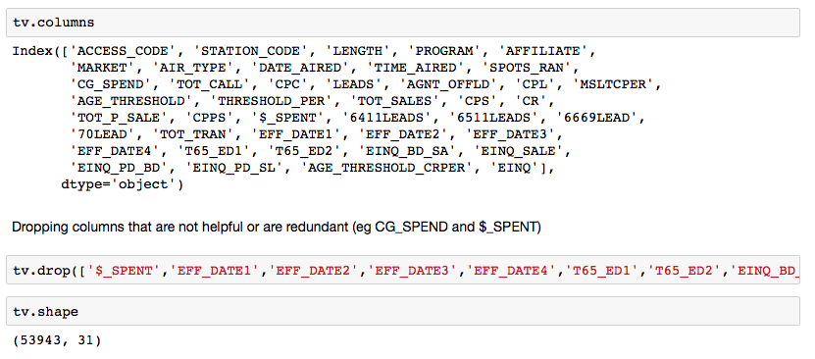
Decision Tree Regressor
Load data, drop unnecessary and collinear columns

Slide 9
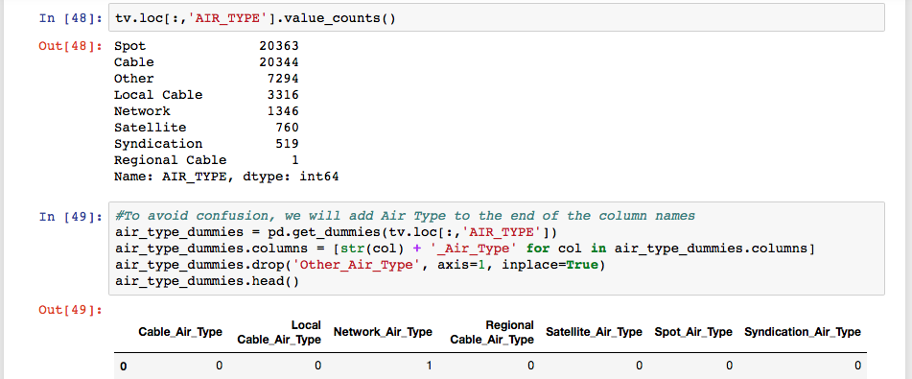
Decision Tree Regressor
Create dummies for the categorical variables: Access Code, Station Code, Length, Program, Affiliate, Market, and Air Type

Slide 10
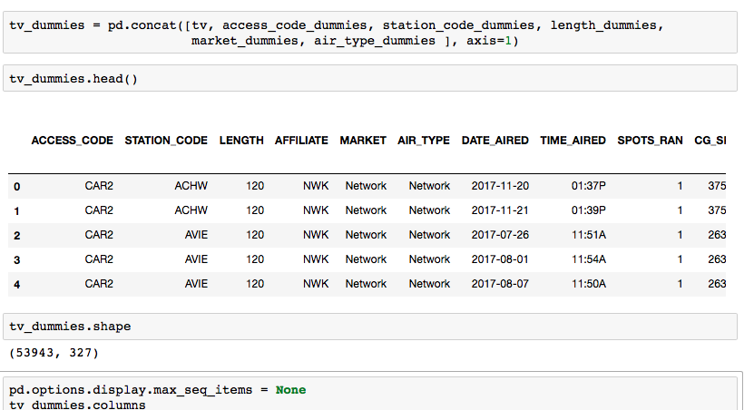
Decision Tree Regressor
Resulting dataframe has 327 columns available for model

Slide 11
Decision Tree Regressor
Approach/Process
Check RMSE of null model (using mean CPS as predicted CPS)
Instantiate Decision Tree Regressor
Create train/test split
Test RMSE of various feature column combinations
Run leave-one-out cross-validation to estimate RMSE for the feature columns selected
Tune model by adjusting max depth
Check Gini importance of each feature
Visualize the model
Test the model on testing data
Check RMSE between test and prediction

Slide 12
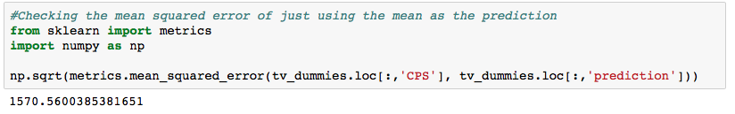
Decision Tree Regressor
Approach/Process
Check RMSE of null model (using mean CPS as predicted CPS)

Slide 13
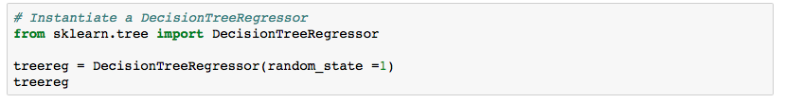
Decision Tree Regressor
Approach/Process
Instantiate Decision Tree Regressor

Slide 14
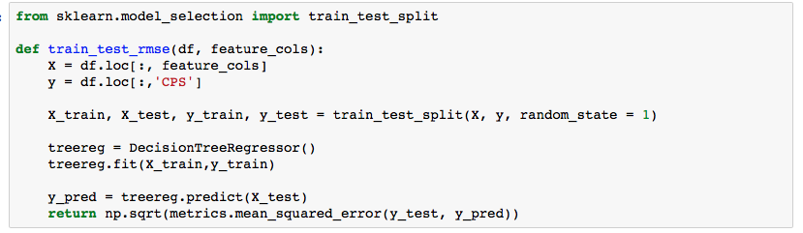
Decision Tree Regressor
Approach/Process
Create train/test split

Slide 15
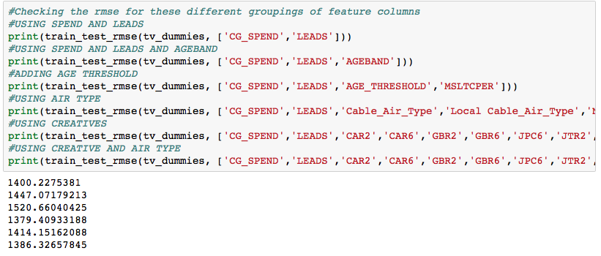
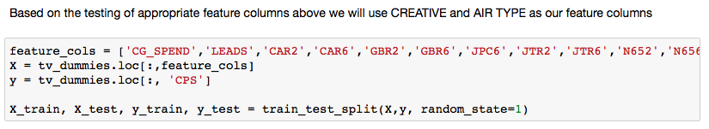
Decision Tree Regressor
Approach/Process
Test RMSE of various feature column combinations

Slide 16
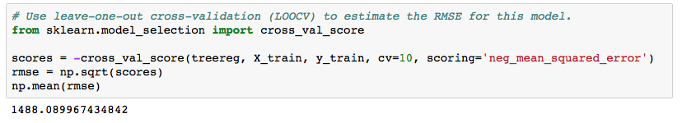
Decision Tree Regressor
Approach/Process
Run leave-one-out cross-validation to estimate RMSE for the feature columns selected

Slide 17
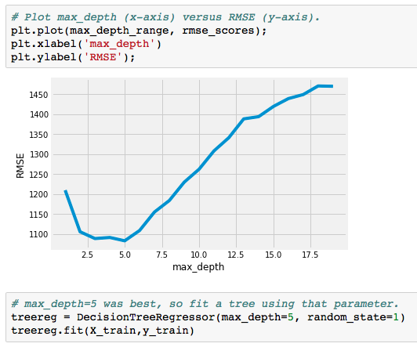
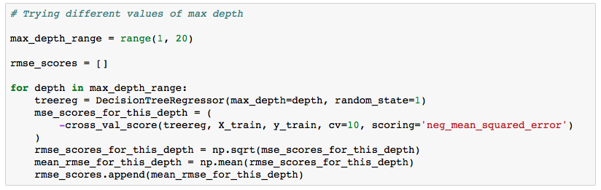
Decision Tree Regressor
Approach/Process
Tune model by adjusting max depth

Slide 18
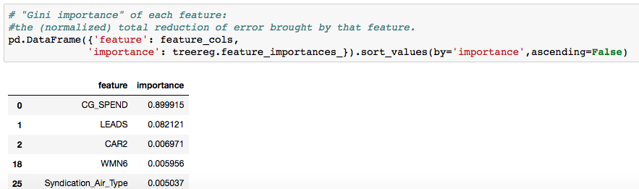
Decision Tree Regressor
Approach/Process
Check Gini importance of each feature

Slide 19
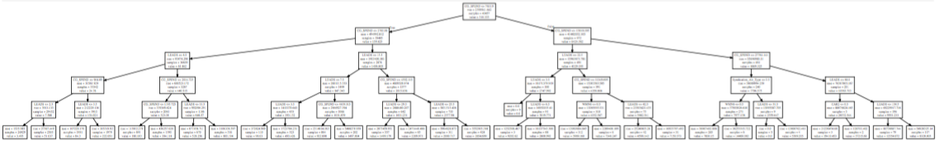
Decision Tree Regressor
Approach/Process
Visualize the model

Slide 20
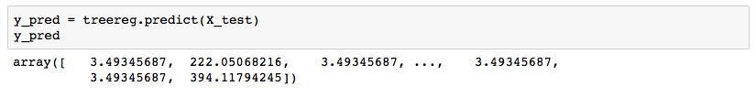
Decision Tree Regressor
Approach/Process
Test the model on testing data

Slide 21
Decision Tree Regressor
Approach/Process
Check RMSE between test and prediction

Slide 22
Resulting Decision Tree Regressor

Slide 23
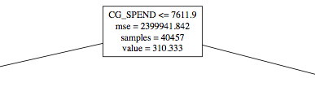
Central node of the Decision Tree Regressor: CG_SPEND

Slide 24
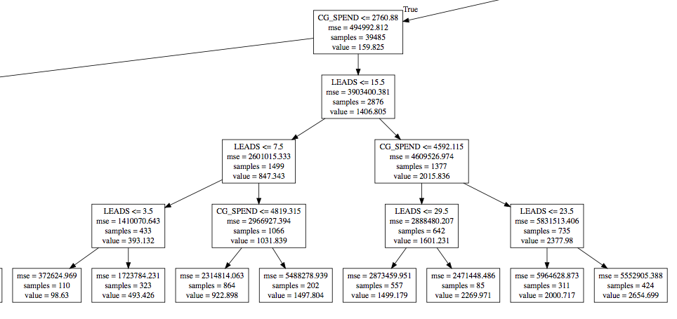
Moving left (True) from central node

Slide 25
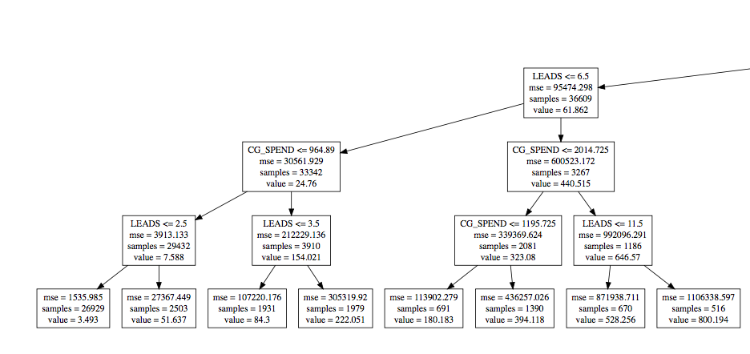
Farthest left from central node

Slide 26
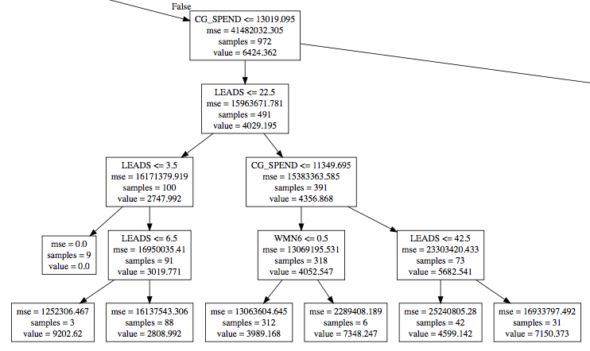
Moving right (False) from central node

Slide 27
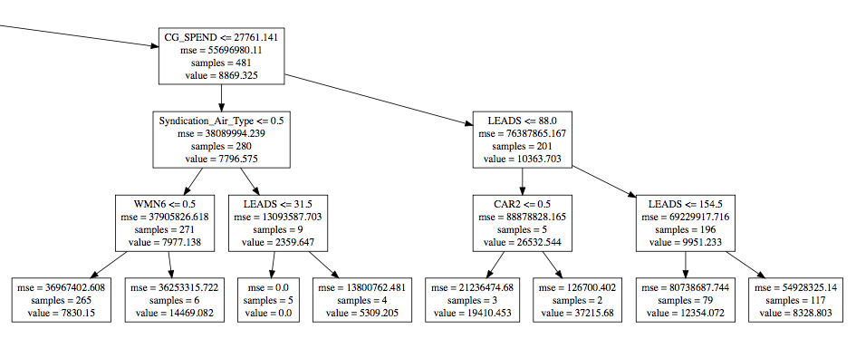
Farthest right from central node

Slide 28
Performance Evaluation
Initial Metrics
Mean CPS: $315
RMSE of a null model: 1570
Model Metrics
RMSE on training data, LOOCV : 1488
RMSE on training data, tuned max depth: 1058
RMSE on testing data: 1113

Slide 29
Impact of findings
Importances
Spend is the highest feature importance, followed by lead volume, 2 creatives, and air type Syndication
Surprisingly, age bands, age thresholds, or conversion from call to lead do not add predictive power to model
Recommendation
Primarily use model to predict cost-per-sale from existing spend/lead data
Be wary of the greedy algorithm at work!

Slide 30
Next Steps
Train media buyers to understand & interpret decision tree
Implementation
Adjust buying based on the decision tree
Finalize model
Train users
Assess accuracy
Adjust buying
Continue testing variations of decision tree with different feature columns and node limitations
Use 10 week mature sales data to re-review predictive accuracy

